Slide 1
DROUGHTS
IN INDIA

Slide 2
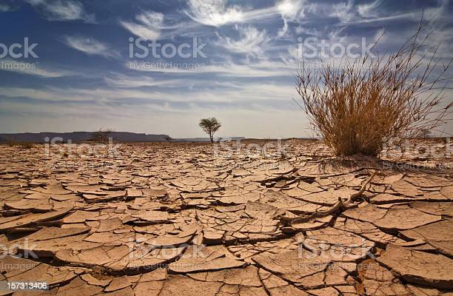
Droughts
When rainfall is less than expected normal rainfall. The low rainfall is insufficient to meet the needs of humans, animals, plants and agriculture is drying of rivers, lake, ponds, wells, poor recharge of underground water.

Slide 3
India has suffered major and worst drought over the 18th and 19th centuries,resulted millions of deaths and led to major Indian famines such as Odisha famine of 1866,Bengal famine of 1943 and Bihar famine of 1873–1874.
States affected by drought in India are Maharashtra, Karnataka, Andhra Pradesh, Orissa, Gujarat and Rajasthan, Major population of these region depended on the rice crop of the winter season. Due to the failure of the monsoon,some parts of Bihar and Jharkhand along with Punjab and Haryana were also affected by drought.

Slide 4
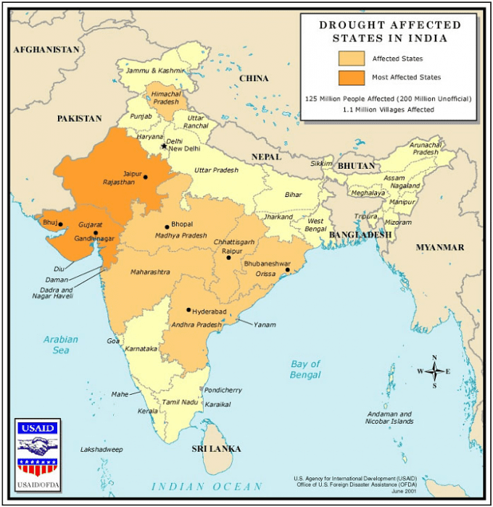

Slide 5
Effects
Severe loss of agriculture.
Affects dairy activities fisheries.
Depletion of underground water.
Loss of bio-diversity.
Social unrest.
Health problems and increased poverty.
Management
A regular monitoring of rainfall water availability in reservoirs, lake, rivers.
To adopt water conservation measures to reduce water consumption.
To adopt efficient methods of irrigation like drip irrigation,sprinkle irrigation.
To reuse waste water.
Growing drought resistant crops.
Rain and roof water harvesting.
To construct small check dams.

Slide 6
THANK YOU

